Slide 1





Mystery
Team Red
Gaurav Kamble, Sanskruti Shimple
Vishwakarma Institute of Technology, Pune

Slide 2
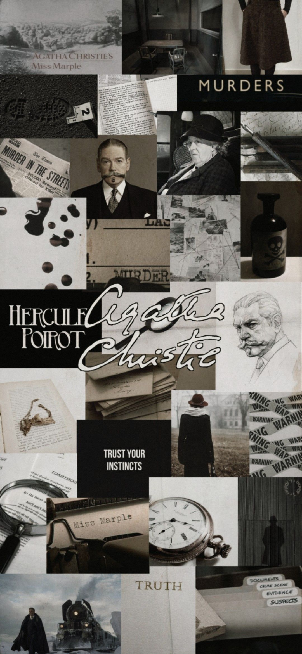
Problem Statement
Miss Marple lives in the village of St. Mary Mead and acts as an amateur consulting detective. She is the Godmother of cosy crime. She is on her way to a new detective mission, but wasn't able to find her Detective Tools/Gadgets. Help her to get new tools by making a Spy Gadget Website application.
Front-end / UI-UX
User Login/Signup Page.
Add at least 6 gadgets
Make a Payment Page / Ordering page.
Items selected must be added to the cart.

Slide 3







Technologies Used
Canva
HTML
CSS
JavaScript
Bootstrap
Ajax
PHP

Slide 4
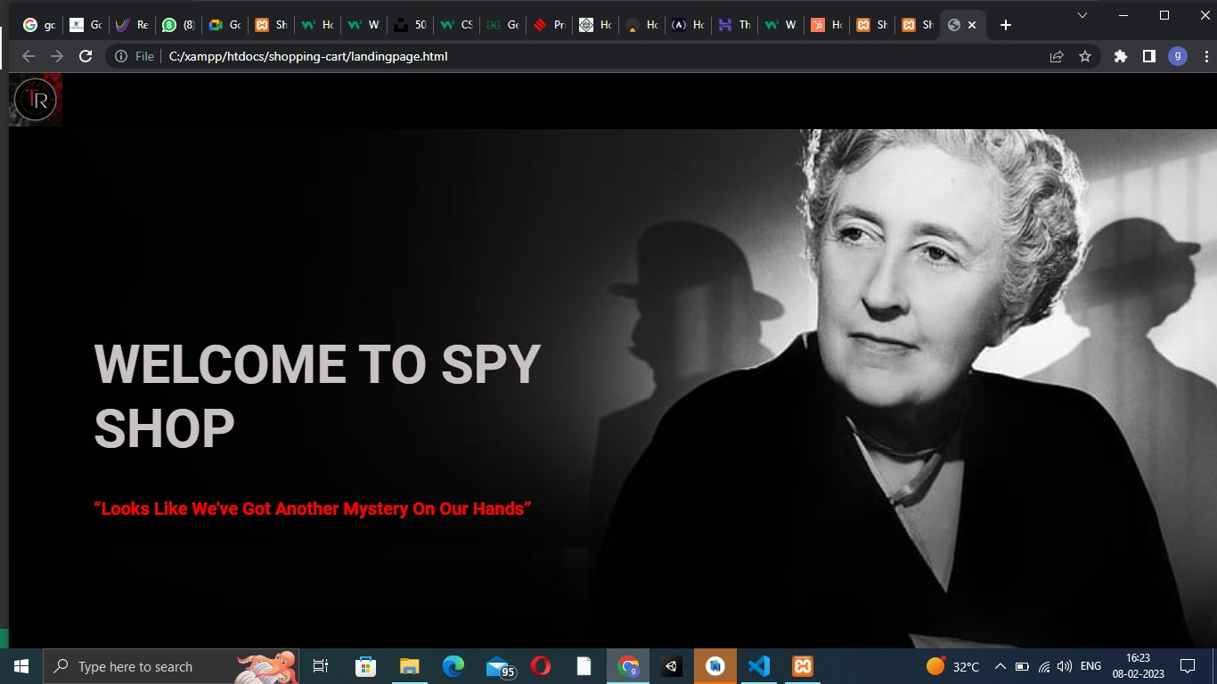
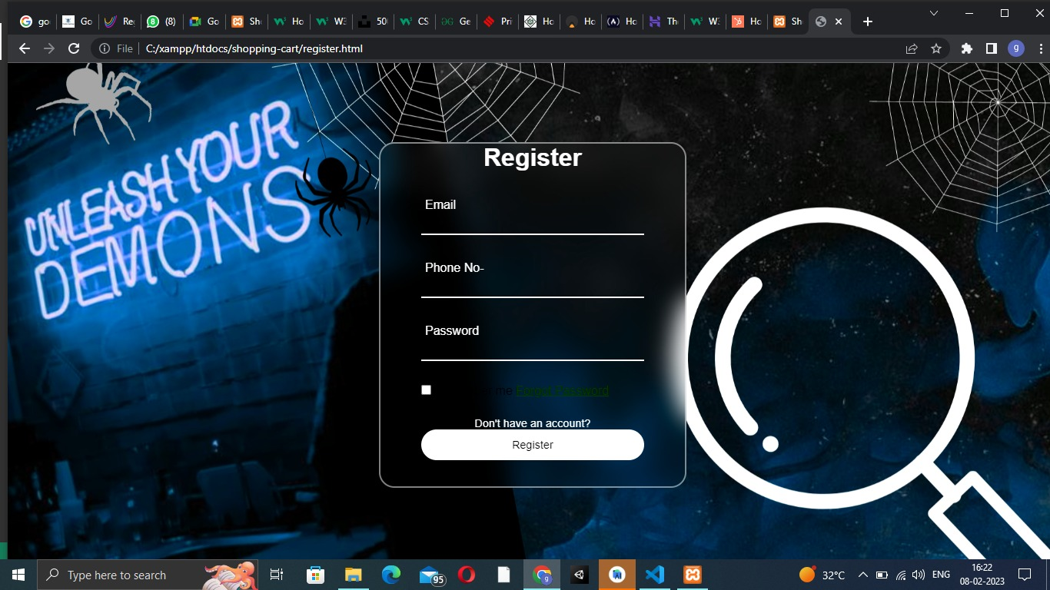
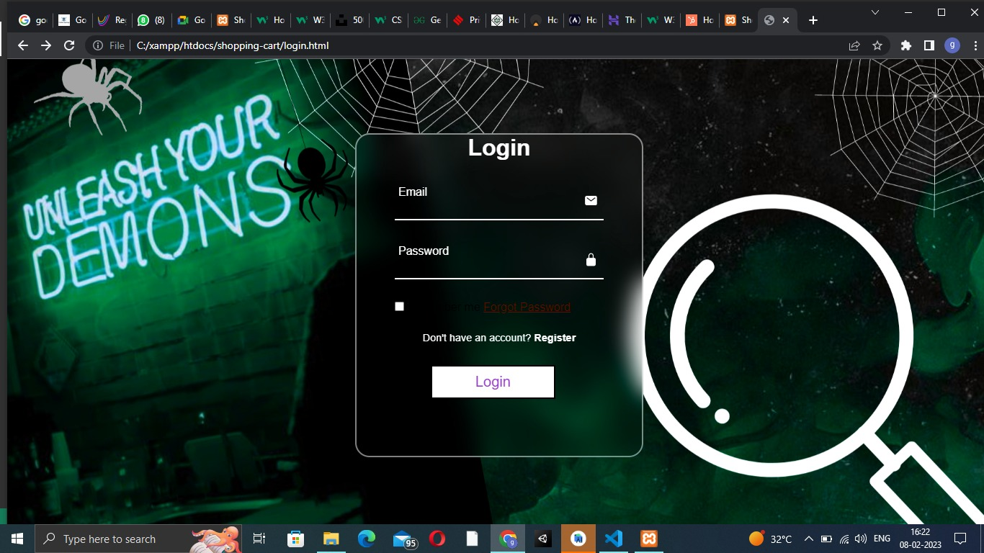
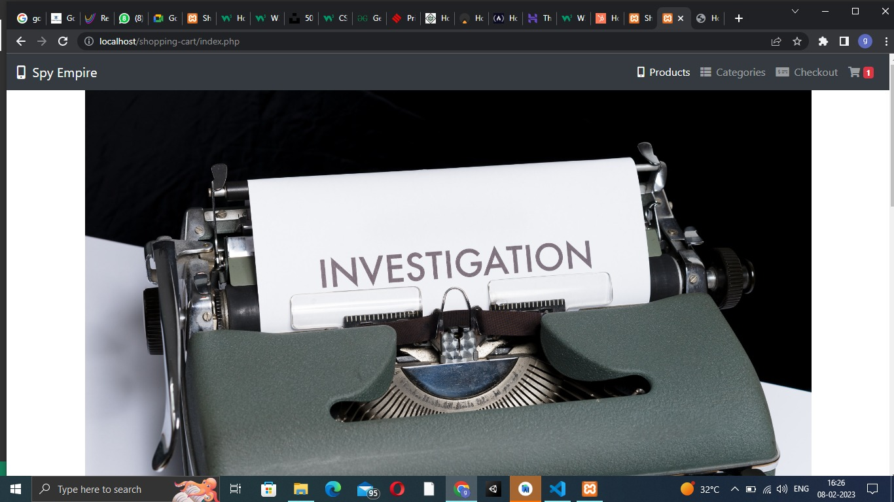
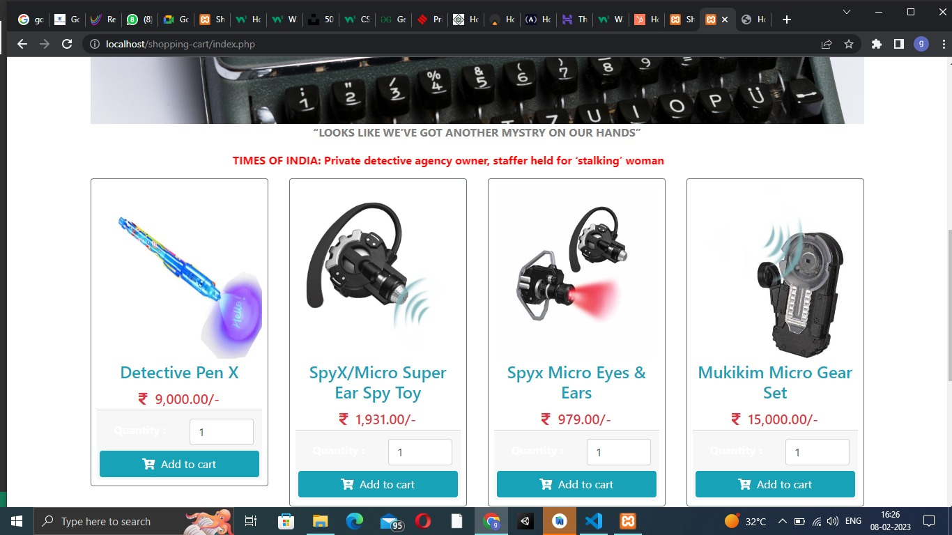
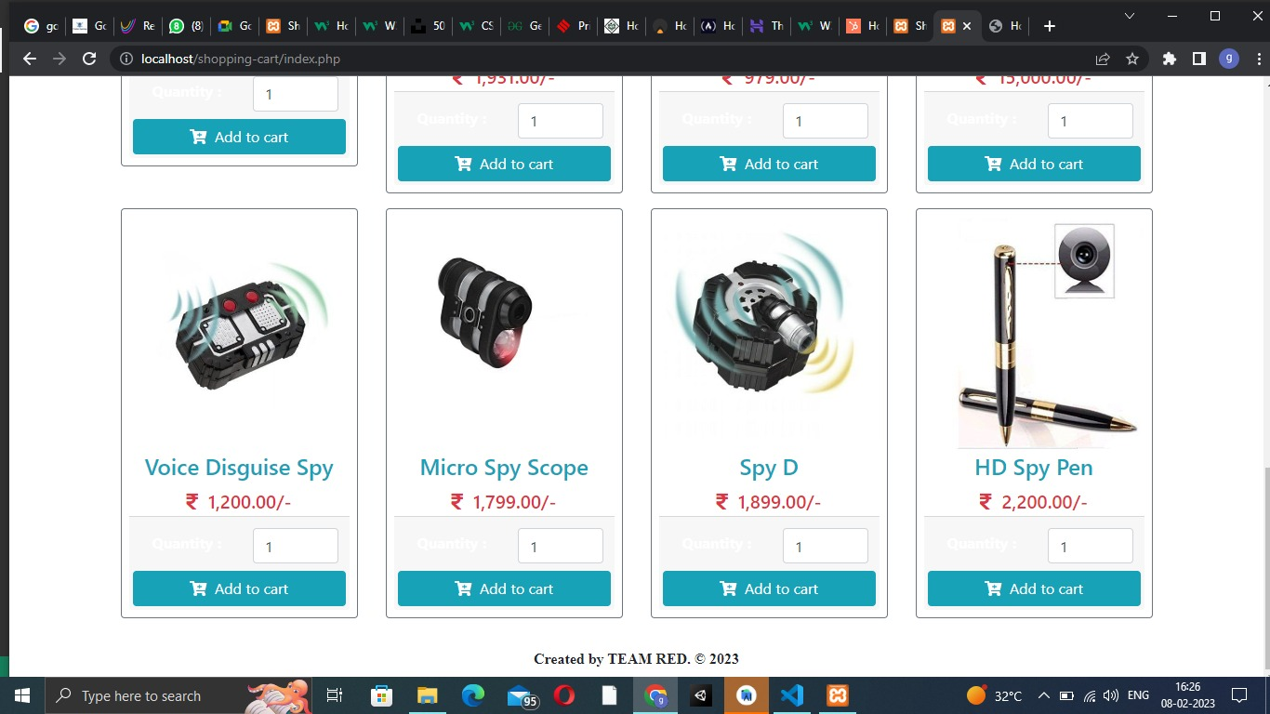
Website Screenshots

Slide 5

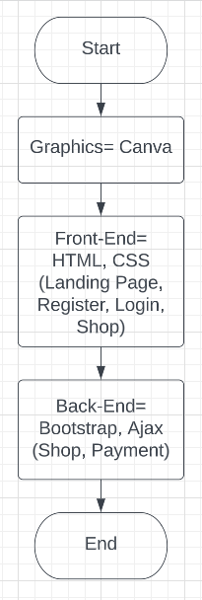
Solution
A full-stack website is developed with the help of some web development technologies. The website is developed as follows:-
The Home Page
Login Page
Register Page
Shop Page
Payment Page

Slide 6
Explanation
Team red elected the theme a mystery, and the problem statement is of developing a Spy Gadget Website application. The website developed is as follows;
The home page is developed with the help of HTML and CSS and the logo is developed with the help of Canva software.
The login and register page is developed with the help of Canva, HTML, and CSS.
The shop page is developed with the help of HTML, CSS, Bootstrap, and Ajax.
The Payment Page is developed with the help of HTML, CSS, Bootstrap, Ajax, and PHP.

Slide 7

Thank You

